Slide 1
Project Benson
Kari Davis
Angela Huang
Nathan Hunt
Ven Tadi

Slide 2
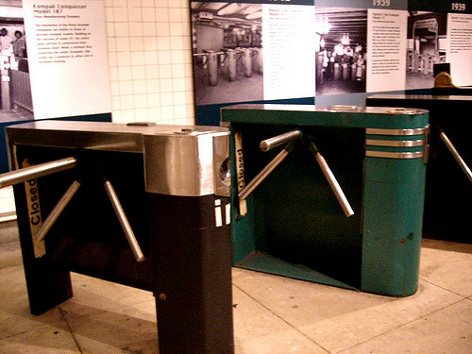
Introduction
WomenTechWomenYes (WTWY) is hosting a gala at the beginning of summer and wants to optimize outreach and awareness
Objective: Dispatch street teams to high traffic stations
Goal: To have the best conversion rate for soliciting attendees and donors to the WTWY gala
Approach: Gathered data from the MTA, NY Census, and tech company surveys

Slide 3
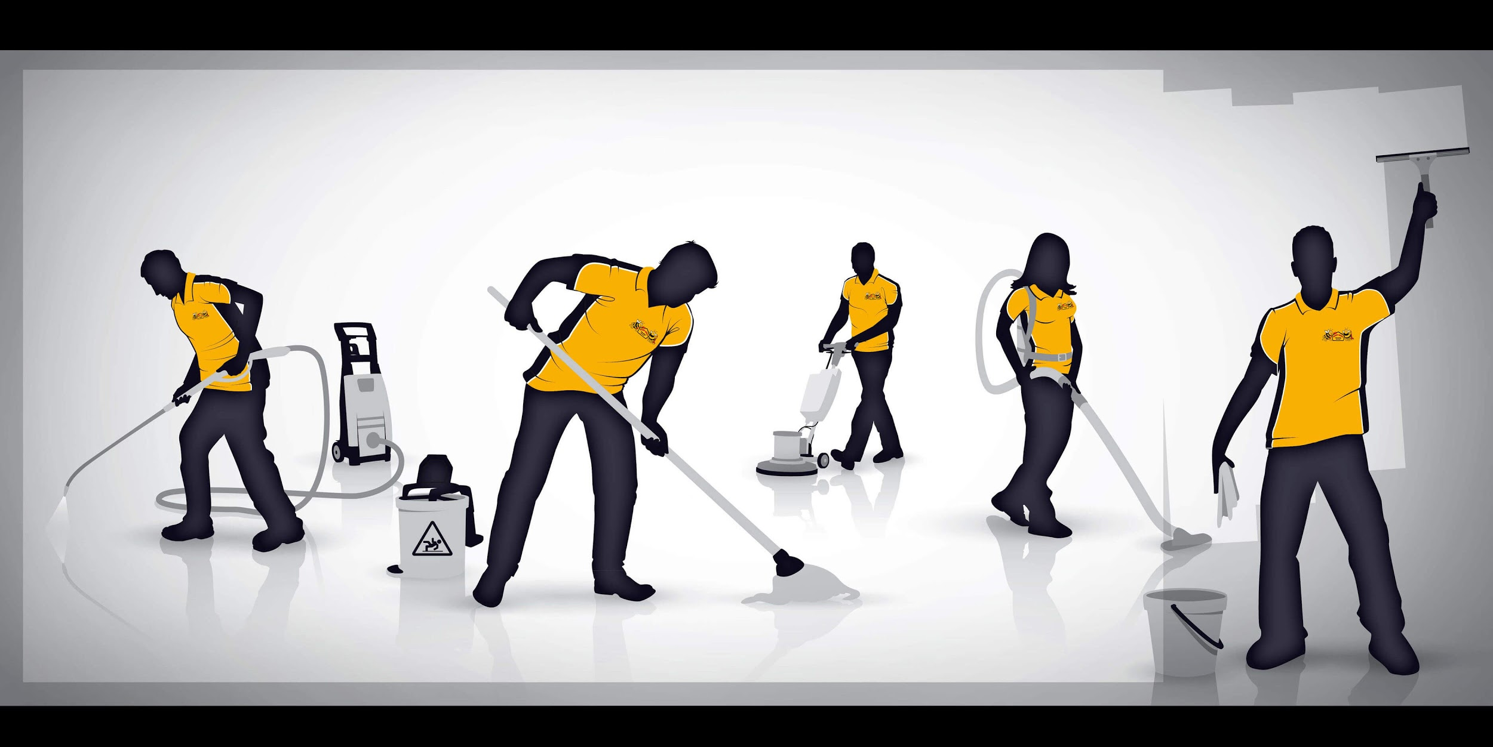
Data Cleaning
Input data: May 2018 MTA Turnstile
Filtered by:
Marked Regular
Net footfalls between 0 and 100,000
Binned by:
Station
Weekday and weekend
4 Hour increments
759,014 turnstile records with entries and exits in the reasonable range.
Maximum observed value: over 5,000 exits at a turnstile at 42nd St. Port Authority.

Slide 4
MTA Data Results

Slide 5
Merged Results
Of the top 20 stations:
5 are in areas with highest income earnings
3 are in areas with highest Female to Male ratio
5 are situated closer to tech companies/tech jobs
Interesting Insight: 67% Women near 116th St & Columbia University Station

Slide 6
Conclusion
Recommendation:
Street Teams | 8:00 | 12:00 | 16:00 | 20:00
1 | Penn Station | Penn Station | Penn Station | Grand Central
2 | Grand Central | Grand Central | Grand Central | Penn Station
3 | Fulton St | Herald Sq | Fulton St | Herald Sq
4 | World Trade Center | Rockefeller Center | Herald Sq | 86 St
5 | Port Authority | 86 St | 86 St | Fulton St
Future Work:
Incorporate maintenance and city events calendars
Group turnstiles by their nearest physical entry/exit to the station
Notes:
Discounted Stations
23 St: stations were too far apart, and not in an area of high income transit takers
Union Sq: not in an area of high income transit takers nor near tech companies/jobs
Times Sq: not in an area of high income transit takers nor near tech companies/jobs + tourist area, not locals
42 Port: not in an area of high income transit takers + high commuter area
59th Columbus: not in an area of high income transit takers nor near tech companies/jobs

Slide 7
Thank You!

